Slide 1



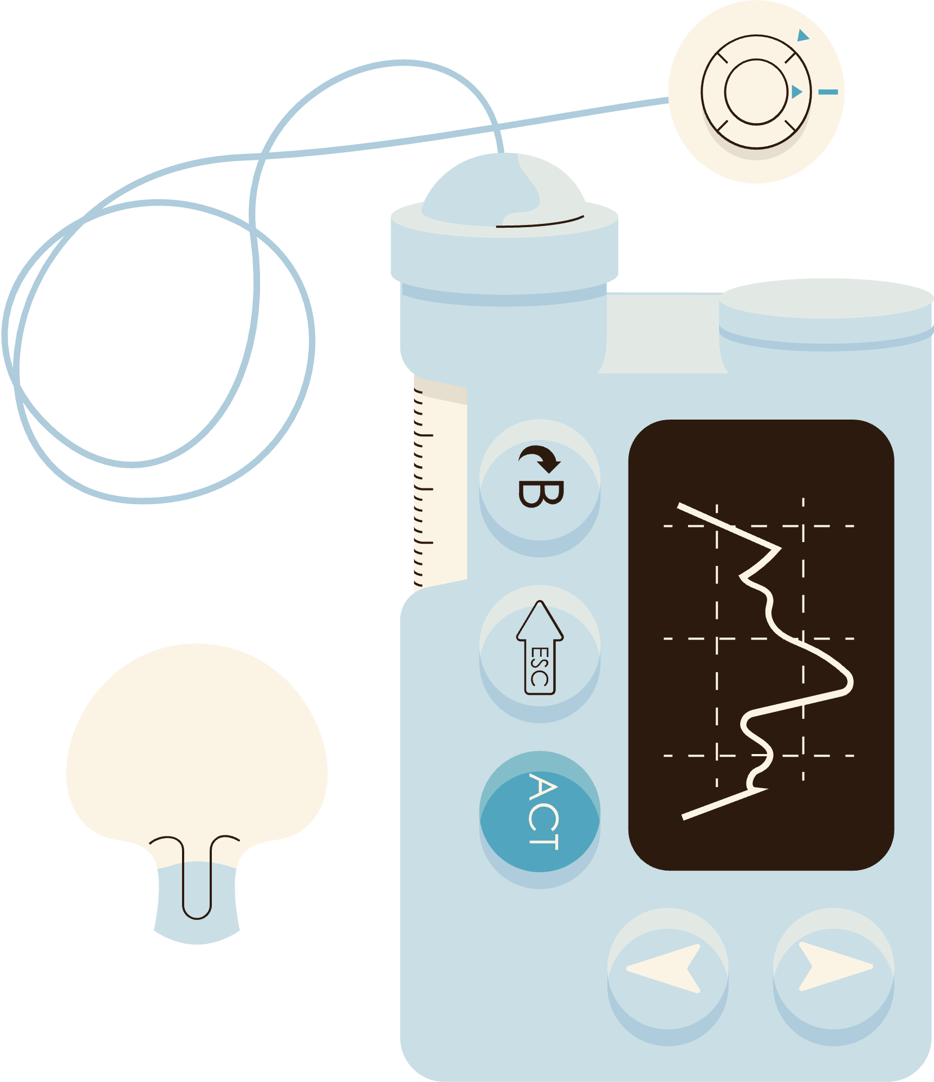


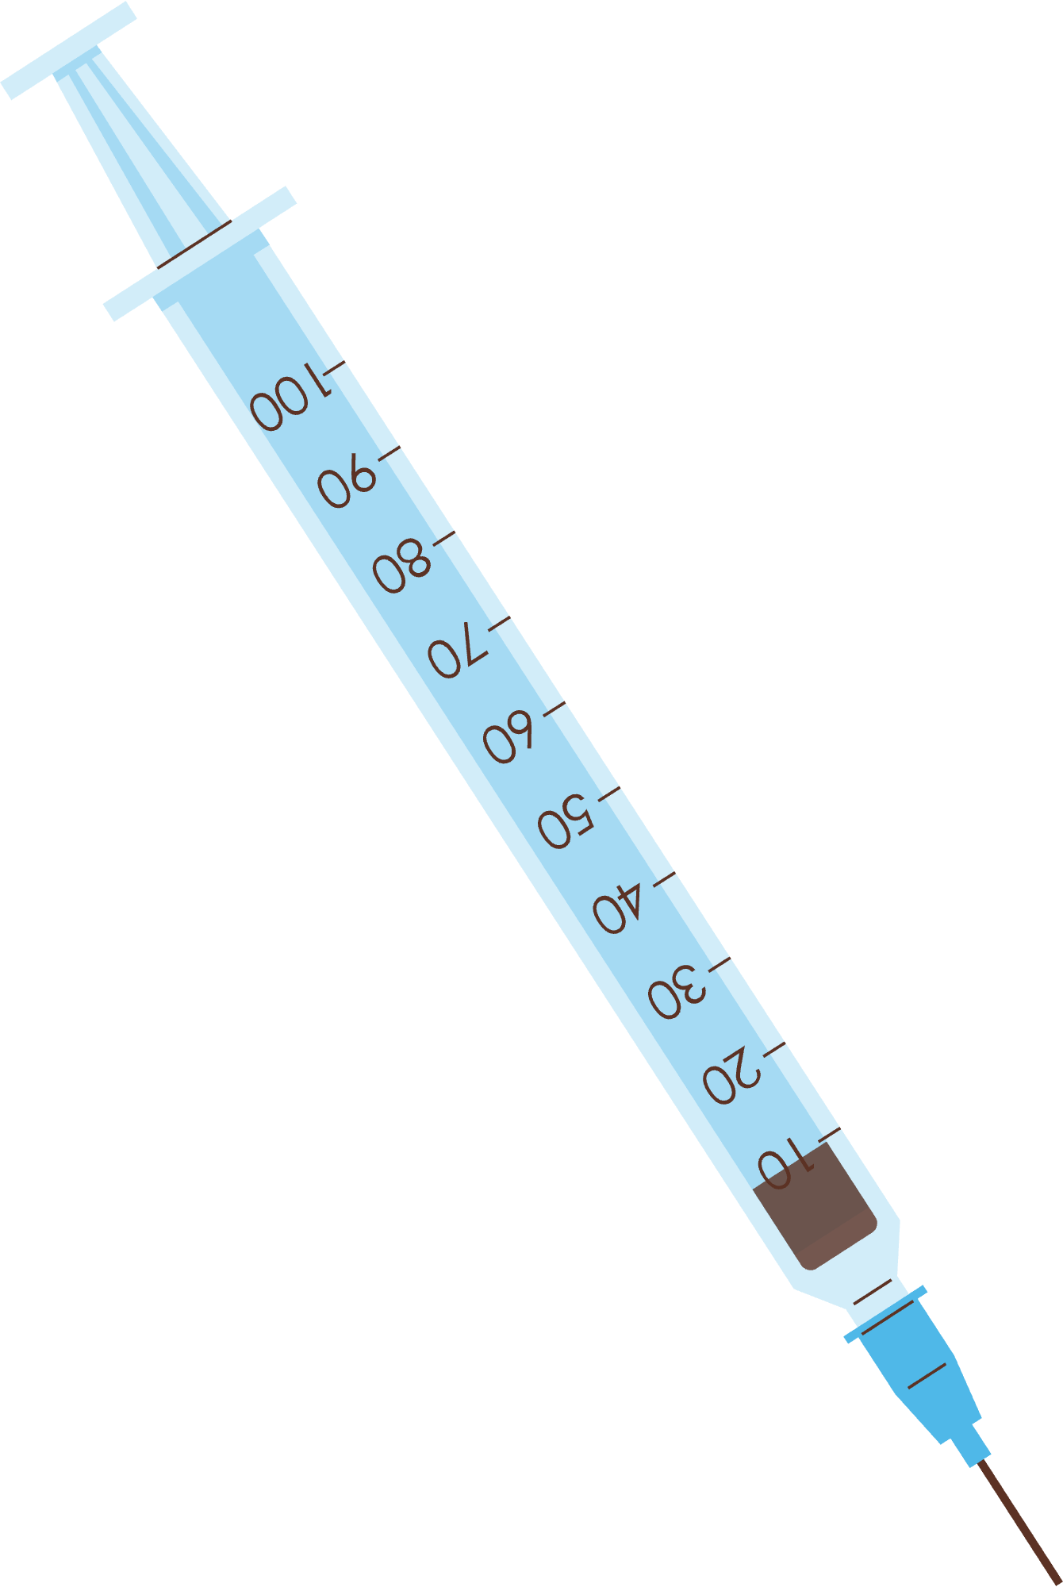


THE EFFECT OF EXPOSURE TO GESTATIONAL DIABETES ON ADIPOSITY IN THE EPOCH STUDY
Sarah Bird

Slide 2
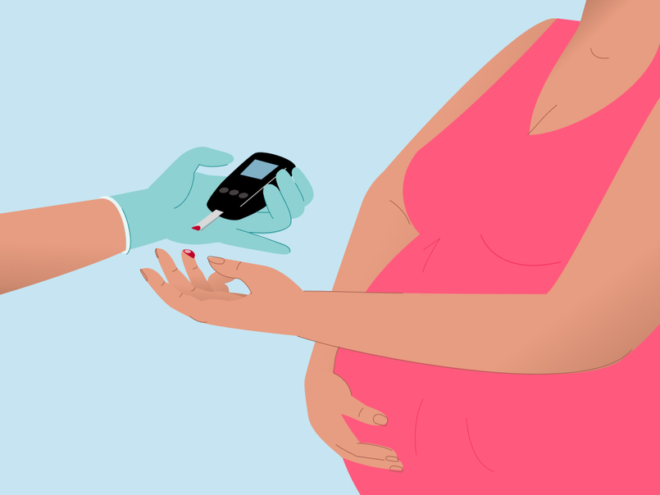
Gestational Diabetes
Type of glucose intolerance that occurs during pregnancy
Exposure to gestational diabetes has been linked to negative health outcomes such as
Increased fetal growth
Fetal overnutrition
Increased offspring body mass
Notes:
Gestational diabetes is a form of glucose intolerance that occurs during pregnancy
Typically diagnosed in the 24th-28th week of preganancy
It’s cause is unknown, but it is hypothesized that hormones produced by the placenta produce hormones that block the ability to use insulin effectively.
Previous studies have linked exposure to gestational diabetes during intrauterine growth with increased fetal growth, adiposity, fetal overnutrition, and development of type 2 diabetes for both mother and child

Slide 3


The Exploring Perinatal Outcomes Among Children (EPOCH) Study
Prospective observational study
Conducted in Aurora, Colorado
Explores the relationship between exposure to gestational diabetes and health outcomes longitudinally in children across childhood and adolescence
Enrolled 604 mother/child dyads

Slide 4

EPOCH Study Design
Childhood Visit
(10 years of age)
Genotyping
Height & Weight
Demographics
Adolescent Visit
(16 years of age)
Height & Weight
Demographics
END OF STUDY
BIRTH
Height and weight were abstracted from KPCO electronic health records

Slide 5
01.
Evaluate the relationship between time to obesity
and exposure to gestational diabetes
Aims for this Study
Evaluate the relationship between time to becoming overweight
and exposure to gestational diabetes
02.

Slide 6

Outcome: Time to obesity/becoming overweight
Obesity: >= 95th percentile
Overweight: >= 85th percentile and < 95th percentile
Semi-parametric cox proportional hazard models
Covariates:
Exposure to GDM
Household Income
Adjusted for left truncation
Diagnostics
Log-log plots
Score residuals
Deviance residuals
*Cleaned BMI trajectories with the Harrall Algorithm, prior to running models*
Methods

Slide 7
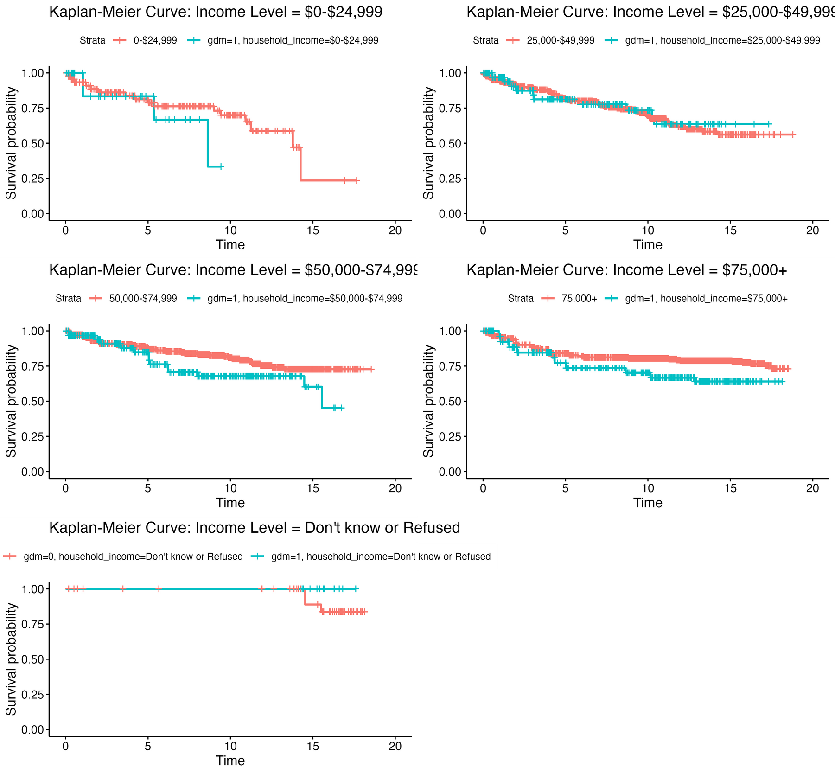
Aim 1: Obesity Outcome
Notes:
The first thing I did was to generate the Kaplan-Meier curves for the models
You can see that the first two curves really cross quite a bit—evidence that the proportional hazards model may not be the best way to go with including this covariate

Slide 8
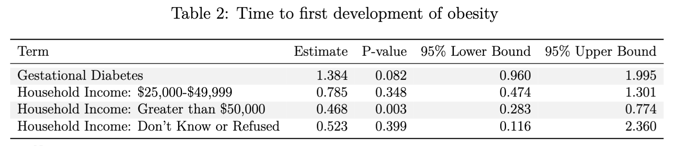
Aim 1: Obesity Outcome
Notes:
The table presents the hazard ratios for each covariate in the model along with their 95% Wald confidence intervals. Time to first instance of obesity was not significantly associated with exposure to gestational diabetes.
Participants exposed to gestational diabetes are 38.4% as likely to experience the first development of obesity as compared to those who weren't, holding income constant.
A likelihood ratio test was performed and revealed that including household income as a time varying covariate was significant.
The hazard of the first instance of obesity in children whose household income is greater than $50,000 is 0.468 times the hazard of children whose household income is less than $25,000.
All other effects were not significant

Slide 9
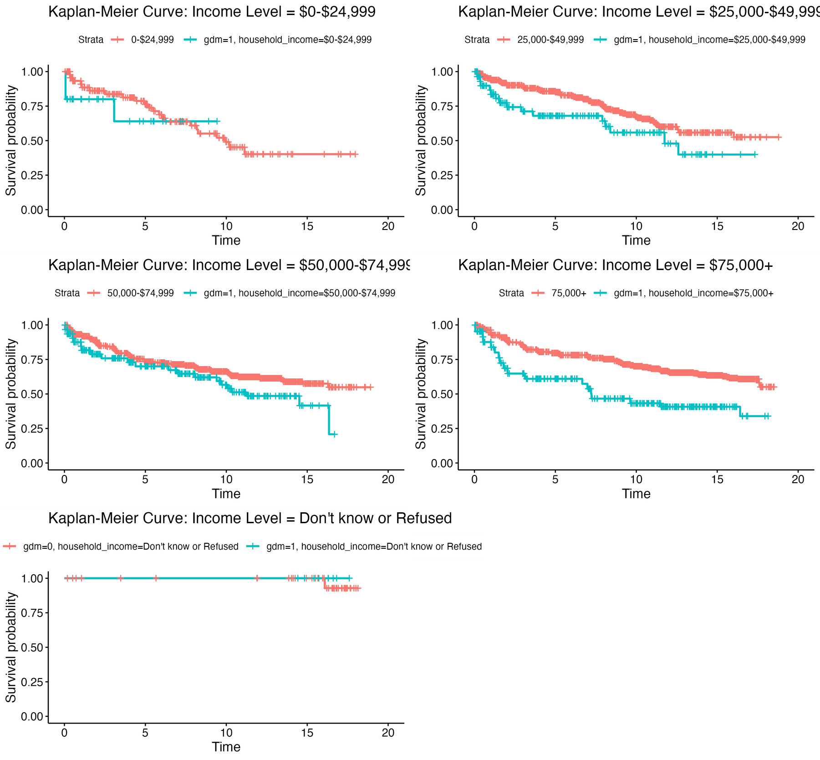
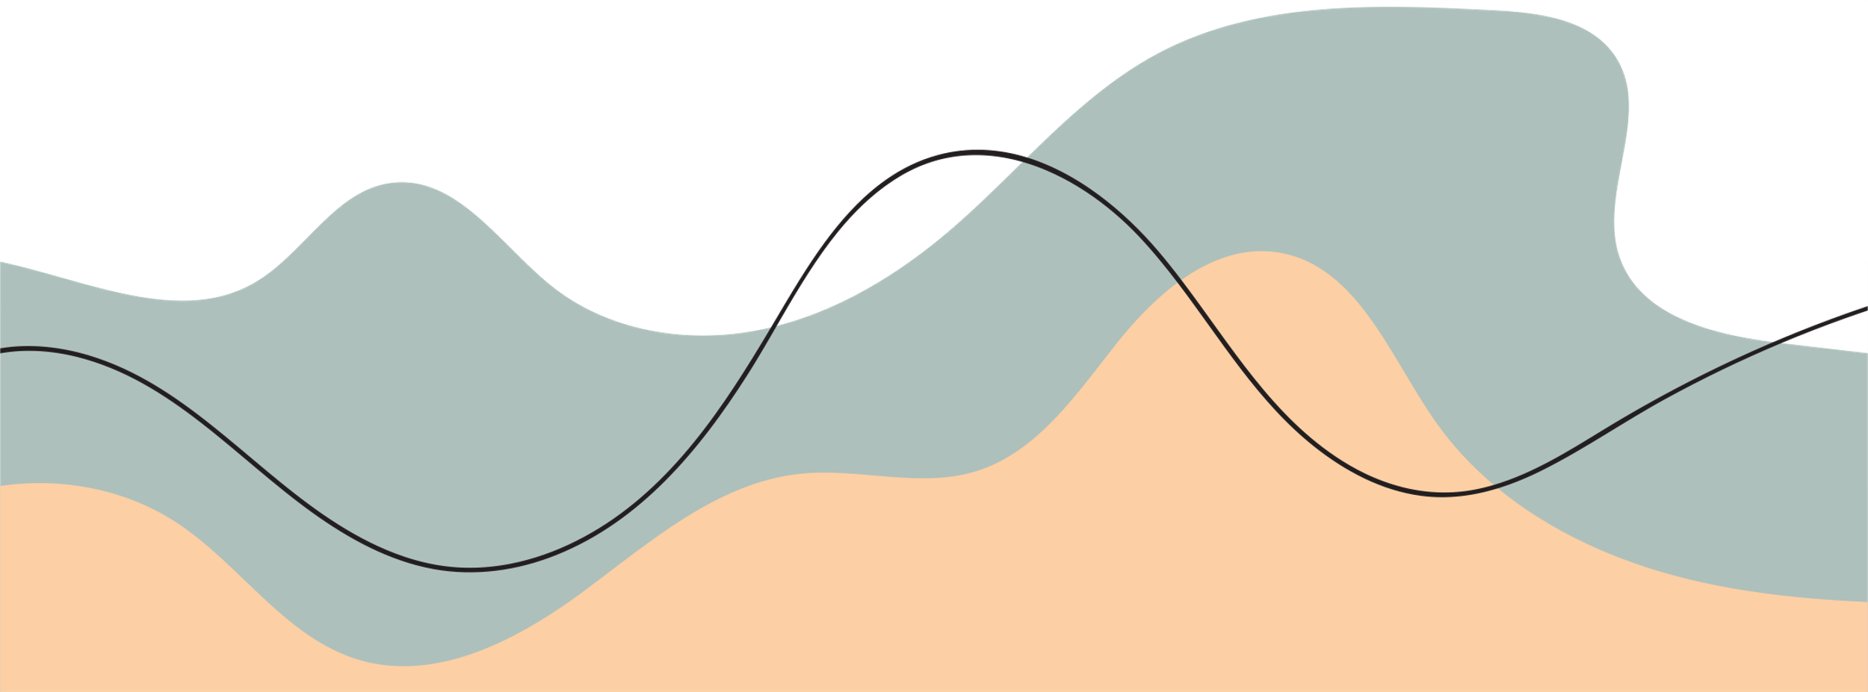
Aim 2: Overweight Outcome

Slide 10
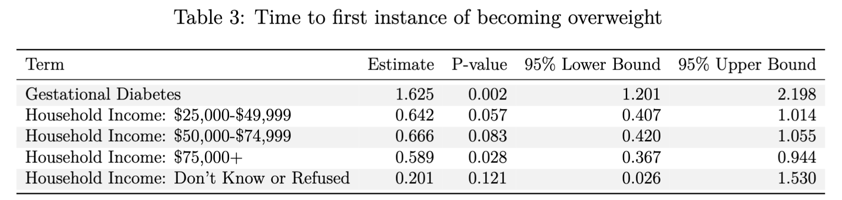
Aim 2: Overweight Outcome
Notes:
Exposure to gestational diabetes was found to be significantly associated with time to first occasion of becoming overweight (p=0.002).
For those who were exposed to gestational diabetes, the hazard of first instance of becoming overweight was increased by 62.5% as compared to those who were not exposed to gestational diabetes, holding income level constant.
Household income was, overall, not found to be significantly associated with time to first occasion of becoming overweight.

Slide 11
01
Exposure to gestational diabetes is significantly associated with time to becoming overweight
Discussion
02
Household income was significantly associated with time to obesity
Notes:
This study examined the association between exposure to gestational diabetes in utero and time to first obesity or first occasion of becoming overweight in the EPOCH study.
We found no evidence that gestational diabetes was associated with first obesity, but that wasn’t the same story with first time to becoming overweight.
We also found evidence that households who had higher income were found to, on average, have a lower hazard of developing obesity
This finding is unsuprisiing as having higher income has been found to be associated with a higher Healthy eating index

Slide 12
Discussion
Limitations
The proportional hazards assumption is questionable
38% drop out between the first and second EPOCH visit was observed in the study
Medical record abstraction likely has some measurement error
This data is interval censored
Extensions of this work
Explore other covariates (i.e. Mother’s education)
Recurrent event analysis?

Slide 13

Thank you!! Questions??

Slide 14
Sample Sizes
Total participants, N = 602
Two participants were excluded because they only had EPOCH I visit data
99 exposed, 503 not exposed
Time to First Instance of Obesity (183 total events)
EPOCH I: 314 observations
EPOCH II: 194 observations
Time to First Instance of Becoming Overweight (257 total events)
EPOCH I: 282 Observations
EPOCH II: 158 Observations

